Slide 1

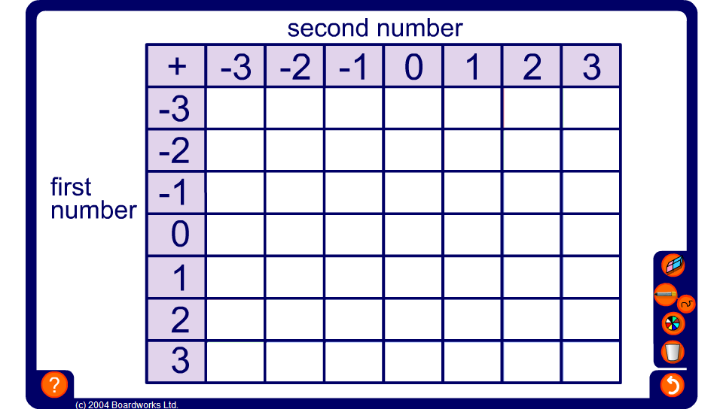


Ordered addition square
Notes:
This addition square can be used to draw the pupils’ attention to the number patterns produced when adding positive and negative integers in order.
Start by working out the positive number additions 3 + 0, 3 + 1, 3 + 2 and 3 + 3.
Ask pupils the answer to 3 + –1, using the number pattern in the table. Fill in the rest of the row to 3 + –3.
Repeat in the same order for the next three rows.
For the last three rows fill in the first answer by looking at the pattern in the first column and continue along the row.
Before revealing each answer ensure that the question corresponding to that cell has been clearly stated. For example,
What is 1 + –2?
Pupils may then look for number patterns to deduce the answer.
Once the table is complete, ask pupils to use the table to answer some given questions.
For example,
Use the table to work out –2 + 1.

